Slide 1

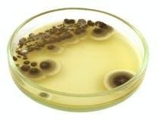
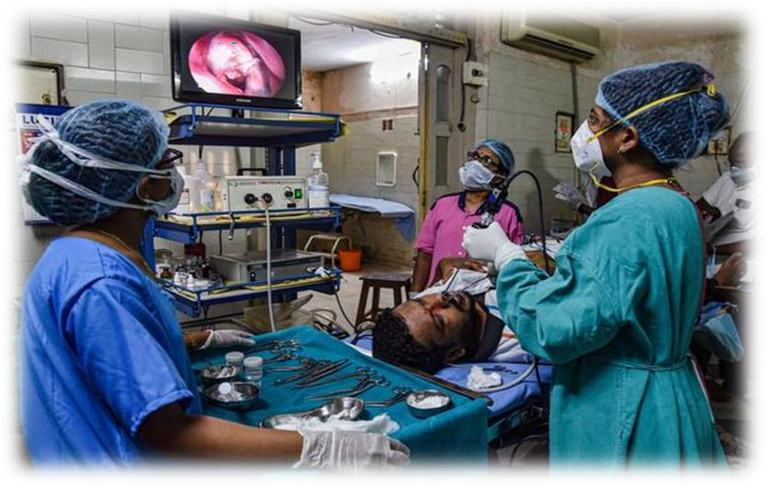
Gujarat Emerges as a HOTSPOT for Mucormycosis
BY-
Vishal Mishra,
Master of Pharmacy
(Mumbai University)

Slide 2
What happened?
With over 2,000 cases, Gujarat has emerged as the hotspot for Mucormycosis or “black fungus”, which has already claimed more than 250 lives in the State.
  The Gujarat government declared the fungal infection, which has a high fatality rate, an epidemic under the provision of the Epidemic Diseases Act, 1897.

Slide 3
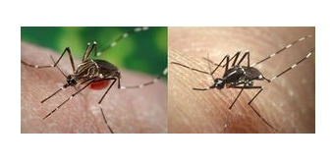
What is endemic, epidemic and pandemic
Endemic - describes a disease that is present permanently in a region or population
Example - malaria

Slide 4
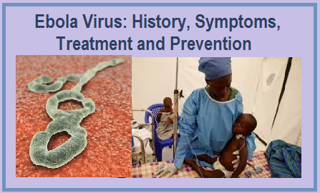
What is endemic, epidemic and pandemic
Epidemic - is an outbreak that affects many people at one time and can spread through one or several communities
Example – Ebola virus

Slide 5
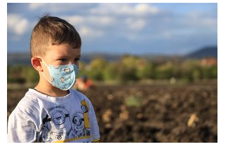
What is endemic, epidemic and pandemic
Pandemic is the term used to describe an epidemic when the spread is global
Example – covid and Spanish flu
All three categories come under communicable disease.

Slide 6
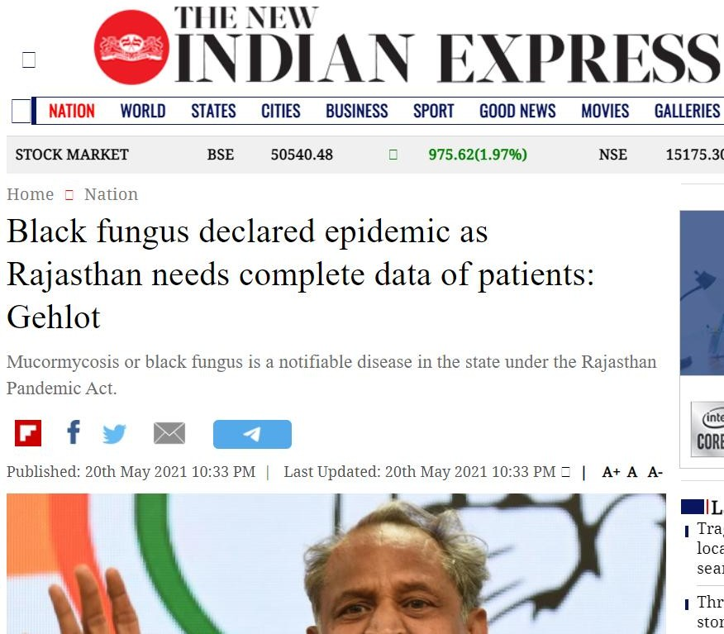

Slide 7
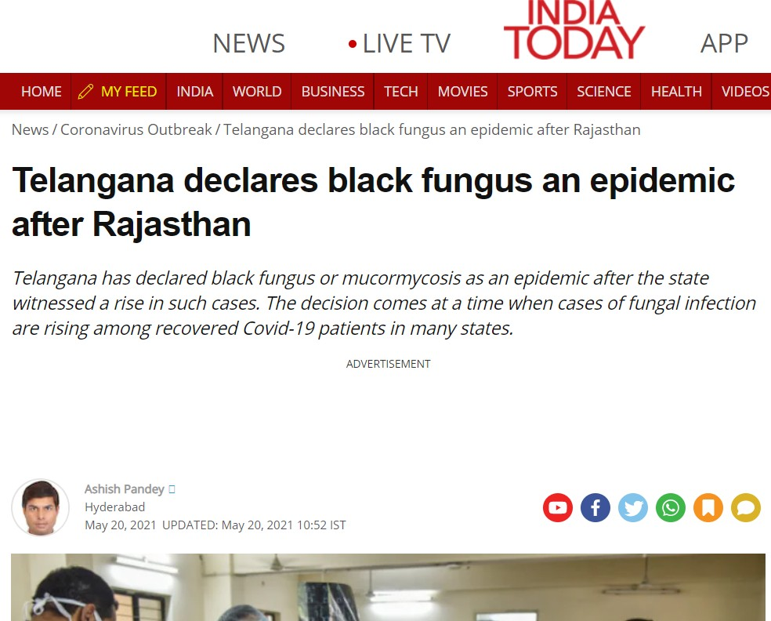

Slide 8
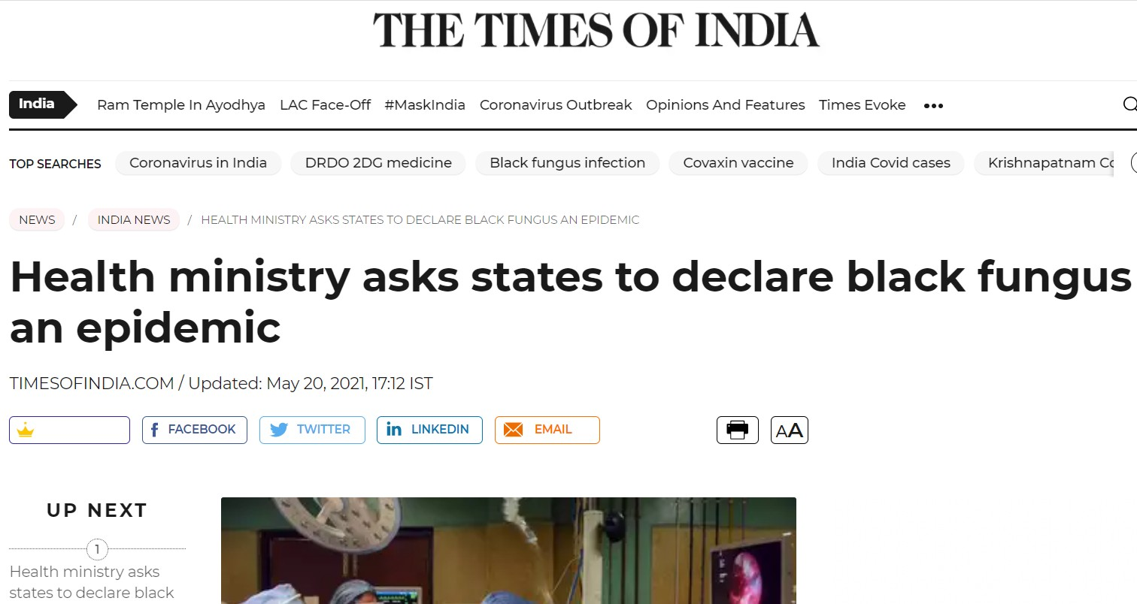

Slide 9
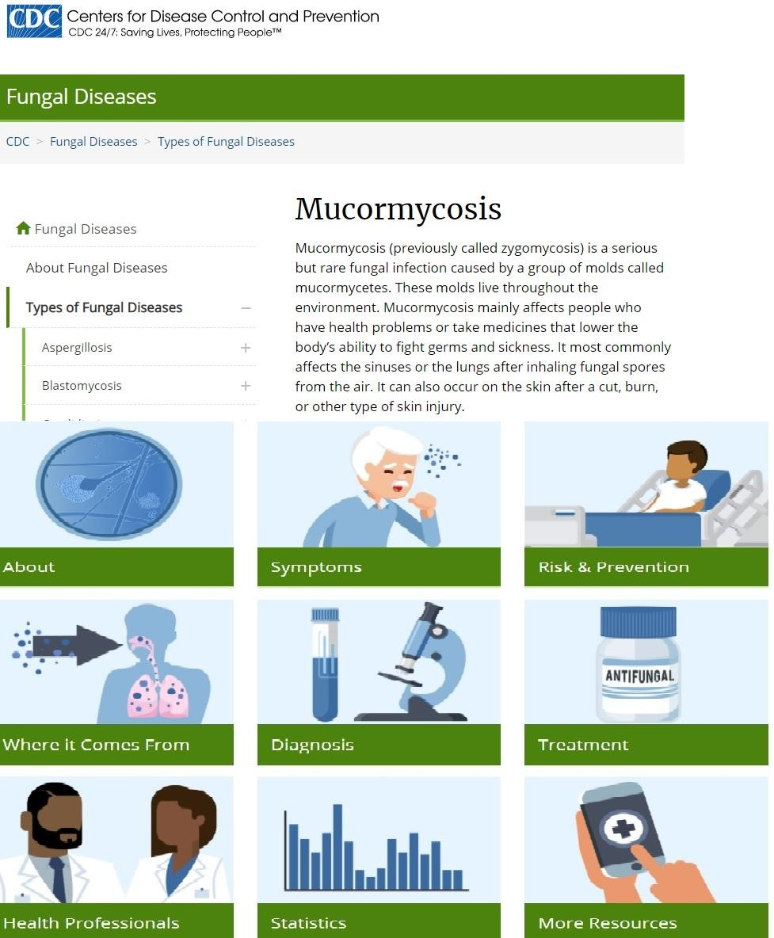

Slide 10
What is Mucormycosis?
Mucormycosis (sometimes called zygomycosis) is a serious but rare fungal infection caused by a group of molds called
mucormycetes.
These fungi live throughout the environment, particularly in soil and in decaying organic matter, such as leaves, compost piles, or rotten wood.
Mucormycosis can also develop on the skin after the fungus enters the skin through a cut, scrape, burn, or other type of skin trauma.

Slide 11
Types of mucormycosis
Rhinocerebral (sinus and brain) mucormycosis
Pulmonary (lung) mucormycosis
Gastrointestinal mucormycosis
Cutaneous (skin) mucormycosis
Disseminated mucormycosis

Slide 12
Symptoms of Mucormycosis
One-sided facial swelling
Headache
Nasal or sinus congestion
Fever
Cough
Chest pain
Shortness of breath

Slide 13
Epidemic Diseases Act, 1897
Section 2A of the Act empowers the central government to take steps to prevent the spread of an epidemic.
  Health is a State subject, but by invoking Section 2 of the Epidemic Diseases Act, advisories and directions of the Ministry of Health & Family Welfare will be enforceable.
It allows the government to inspect any ship arriving or leaving any post and the power to detain any person intending to sail or arriving in the country

Slide 14
Penalty for Disobedience
Section 3 provides penalties for disobeying any regulation or order made under the Act. These are according to section 188 of the
Indian Penal Code.
  Section 4 gives legal protection to the implementing officers acting under the Act.

Slide 15
Conclusion
(How is mucormycosis treated?)
Mucormycosis is a serious infection and needs to be treated with prescription antifungal medicine,usually amphotericin B, posaconazole, or isavuconazole.
  These medicines are given through a vein or by mouth.
  Mucormycosis requires surgery to cut away the infected tissue.

Slide 16
Any question

Slide 17
Thank you

